Slide 1

Personalization in e-learning systems
prof. dr Mirjana Ivanović
dr Aleksandra Klašnja-Milićević
Department of Mathematics and Informatics
Faculty of Sciences, Novi Sad
Workshop 2014, Sinaia, Romania

Slide 2
Outline
Introduction
1
Introduction
2
Recommender Systems, Collaborative tagging, Tag-based Personalized RS
3
Recommender Systems in E-learning Environments
4
Design, Architecture and Interface of Protus System
5
Evaluation and Discussion
6
Conclusions
Notes:
(Introduction: Motivation and)

Slide 3
Personalization in e-learning systems
Personalization is becoming an important feature in e-learning systems due to the:
  huge information, the strong interactivity, the great coverage and no space-time restrictions,
  differences in background, goals, capabilities and personalities of the large numbers of learners, the main users of such systems.
Personalization can be achieved using:
  pre-defined rules that sequentially propose learning objects in a specified learning path,
  heuristic rules,
  user models and
  recommendation techniques.

Slide 4
Outline
✓
1
Introduction
2
Recommender Systems, Collaborative tagging, Tag-based Personalized RS
3
Recommender Systems in E-learning Environments
4
Design, Architecture and Interface of Protus System
5
Evaluation and Discussion
6
Conclusions
Notes:
(Introduction: Motivation and)

Slide 5
Recommender systems
Recommender systems use the opinions of a community of users to help individuals in that community more effectively identify content of interest
  E.g. music, books and movies
  In eCommerce recommend items
  In eLearning recommend content - learning objects
Help users make decisions
Types of Recommender Systems
  Collaborative Filtering (CF) – match ‘like-minded’ people
  Content-Based (CB) – use personal preferences to match and filter items
  Recommendation systems based on association rules mining technologies

Slide 6
Collaborative filtering
Match people with similar interests as a basis for recommendation
Users rate items. Ratings may be:
  Explicit, e.g. buying or rating an item
  Implicit, e.g. browsing time, number of mouse clicks
Nearest neighbor matching used to find people with similar interests
Items that neighbors rate highly but that user has not rated are recommended to him
User can then rate recommended items

Slide 7
Collaborative filtering
A 9
B 3
C
: :
Z 2
A
B
C 9
: :
Z 10
A 5
B 3
C
: :
Z 7
A
B
C 8
: :
Z
A 6
B 4
C
: :
Z
A 10
B 4
C 8
. .
Z 1
User
Database
A 9
B 3
C
: :
Z 2
A 10
B 4
C 8
. .
Z 1
Correlation
Match
A 9
B 3
C
. .
Z 2
Extract
Recommendations
Active
User
C

Slide 8
Collaborative filtering
Very successful methodology in almost every domain – especially “where multi-value ratings are available”
However, they suffer from two key problems:
As most users only rate a small portion of all items, it is highly difficult to find users with “significantly similar ratings.”
Sparsity
An item cannot be recommended before one user has rated it. This can be the case if the item has newly been introduced to the system
First-rater problem

Slide 9
Collaborative tagging
To improve recommendation quality, metadata such as content information of items - additional knowledge
Collaborative tagging is the practice of allowing users to freely attach keywords or tags to content
The systems can be distinguished - kind of resources are supported.
  Flickr - allows the sharing of photos,
  del.icio.us - allows the sharing of bookmarks,
  CiteULike and Connotea - allows the sharing of bibliographic references, and
These systems are all very similar.
Once a user is logged in, he can add a resource to the system, and assign arbitrary tags to it.

Slide 10
Tag-Based Recommender Systems
Tag - a user’s personal opinion expression, while
Tagging - implicit rating or voting on the tagged information resources or items.
Thus, the tagging information can be used to make recommendations
In tag recommender systems the recommendations are:
  for a given user and a given resource , a set of tags
  In many cases, is computed by first generating a ranking on the set of tags according to some quality or relevance criterion, from which then the top n elements are selected

Slide 11
Tag-based Personalized Recommendation Technique
Most popular tags
Collaborative filtering based on collaborative tagging
Tensor Factorization Technique
FolkRank and HOSVD

Slide 12
Outline
✓
1
Aims and Research Objectives of the Dissertation
✓
2
Recommender Systems, Folksonomy and Tag-based Recommender Systems
3
Recommender Systems in E-learning Environments
4
Design, Architecture and Interface of Protus System
5
Evaluation and Discussion
6
Conclusions
Notes:
(Introduction: Motivation and)

Slide 13
RSs in E-learning Environments
To design an effective RS in e-learning environments, it is important to understand specific learners’ characteristics:
  learning goal,
  prior knowledge,
  learner grouping,
  rated learning activities (LAs),
  learning paths, and
  learning strategies, desired in a RS.
E-learning systems should be able to recognize and exploit these learners’ characteristics serve as guidelines for framework design and platform implementation for a good RS for e-learning:

Slide 14




Features of appropriate RS for e-learning
A good RS should be highly personalized.
A good RS should recommend materials at the appropriate time and location.
A good RS should support the continuous learning process.
A good RS should provide appropriate course materials according to learners’ learning style .
Notes:
Animated picture buttons grow and turn on path
(Advanced)
To reproduce the curved shape on this slide, do the following:
On the Home tab, in the Slides group, click Layout, and then click Blank.
On the Home tab, in the Drawing group, click Shapes, and then under Basic Shapes click Right Triangle (first row, fourth option from the left).
On the slide, draw a triangle. Under Drawing Tools, on the Format tab, in the Size group, enter 7.5” into the Height box and enter 4.75” into the Width box.
On the Home tab, in the Drawing group, click Arrange, point to Align, and then do the following:
Click Align Middle.
Click Align Left.
On the slide, select the triangle. Under Drawing Tools, on the Format tab, in the Insert Shapes group, click Edit Shape, and then click Edit Points. Right-click the diagonal side of the triangle, and then click Curved Segment. Click the bottom right corner of the triangle and then move the curve adjustment handle to create a consistent curve.
Also on the Format tab, in the Shape Styles group, click Shape Fill, and then under Theme Colors click White, Background 1 (first row, first option from the left).
Also on the Format tab, in the Shape Styles group, click Shape Outline, and then click No Outline.
To reproduce the background effects on this slide, do the following:
On the Design tab, in the Background group, click Background Styles, and then click Format Background. In the Format Background dialog box, click Fill in the left pane, select Gradient fill in the Fill pane, and then do the following:
In the Type list, select Linear.
In the Angle box, enter 225.
Under Gradient stops, click Add gradient stops or Remove gradient stops until two stops appear in the slider.
Also under Gradient stops, customize the gradient stops as follows:
Select the first stop in the slider, and then do the following:
In the Position box, enter 0%.
Click the button next to Color, and then under Theme Colors click White, Background 1 (first row, first option from the left).
In the Transparency box, enter 0%.
Select the first stop in the slider, and then do the following:
In the Position box, enter 100%.
Click the button next to Color, click More Colors, and then in the Colors dialog box, on the Custom tab, enter values for Red: 230, Green: 230, Blue: 230.
To reproduce the picture and text effects on this slide, do the following:
On the Insert tab, in the Images group, click Picture. In the Insert Picture dialog box, select a picture, and then click Insert.
On the slide, select the picture. Under Picture Tools, on the Format tab, in the Size group, click the arrow under Crop, click Crop to Shape, and then under Basic Shapes click Oval (first option from the left).
With the picture still selected, under Picture Tools, on the Format tab, in the Size group, click the Size and Position dialog box launcher. In the Format Picture dialog box, resize or crop the image so that the height is set to 1.2” and the width is set to 1.2”. To crop the picture, click Crop in the left pane, and in the right pane, under Crop position, enter values into the Height, Width, Left, and Top boxes. To resize the picture, click Size in the left pane, and in the right pane, under Size and rotate, enter values into the Height and Width boxes.
Also in the Format Picture dialog box, click 3-D Format in the left pane, and then, in the 3-D Format pane, do the following:
Under Bevel, click the button next to Top and click Circle (first row, first option from the left).
Under Surface, click the button next to Material, and then under Standard click Metal (fourth option from the left).
Click the button next to Lighting, and then under Neutral click Contrasting (second row, second option from the left).
In the Angle box, enter 25°.
Also in the Format Picture dialog box, click Shadow in the left pane. In the Shadow pane, click the button next to Presets, under Outer click Offset Diagonal Bottom Left (first row, third option from the left), and then do the following:
In the Transparency box, enter 77%.
In the Size box, enter 100%.
In the Blur box, enter 10 pt.
In the Angle box, enter 141°.
In the Distance box, enter 10 pt.
On the slide, drag the picture onto the curve, near the top.
On the Insert tab, in the Text group, click Text Box. On the slide, drag to draw the text box.
Enter text in the text box and select it. On the Home tab, in the Font group, do the following:
In the Font list, select Corbel.
In the Font Size box, enter 22.
Click the arrow next to Font Color, and then under Theme Colors click White, Background 1, Darker 50% (sixth row, first option from the left).
On the Home tab, in the Paragraph group, click Align Text Left to align the text left in the text box.
On the slide, drag the text box to the right of the picture.
To reproduce the animation effects on this slide, do the following:
It will help to zoom out in order to view the area off the slide. On the View tab, in the Zoom group, click Zoom. In the Zoom dialog box, select 65%.
On the Animations tab, in the Advanced Animation group, click Add Animation, and then click More Entrance Effects. In the Add Entrance Effect dialog box, under Moderate, click Grow & Turn, and then click OK.
On the Animations tab, in the Timing group, in the Start list, select With Previous.
On the Animations tab, in the Timing group, in the Duration box, enter 1.
On the Animations tab, in the Advanced Animation group, click Add Animation, and then under Motion Paths click Arcs.
On the Animations tab, in the Timing group, in the Start list, select With Previous.
On the Animations tab, in the Timing group, in the Duration box, enter 1.
On the Animations tab, in the Animation group, click Effect Options, and then click Right.
On the Animations tab, in the Animation group, click Effect Options, and then click Reverse Path Direction.
On the slide, select the arc effect path, and then drag the bottom sizing handle below the bottom of the slide. Drag the right side sizing handle to the left until the path curve approximately matches the curve of the modified triangle. Drag the green rotation handle to the left to rotate the arc path to match the curve of the modified triangle. Drag the arc path so that the red arrow is in the center of the picture. You may need to make further adjustments to the length, width, and angle of the arc path to match the curve of the modified triangle.
On the slide, select the text box. On the Animations tab, in the Advanced Animation group, click Add Animation, and then under Entrance click Fade.
On the Animations tab, in the Timing group, in the Start list, select After Previous.
On the Animations tab, in the Timing group, in the Duration box, enter 1.
To reproduce the other animated pictures and text boxes on this slide, do the following:
On the Animations tab, in the Advanced Animation group, click Animation Pane.
On the slide, press and hold CTRL and then select the picture and the text box. On the Home tab, in the Clipboard group, click the arrow next to Copy, and then click Duplicate.
On the slide, drag the duplicate picture and text onto the curve below the first group.
On the slide, select the duplicate picture. Under Picture Tools, on the Format tab, in the Adjust group, click Change Picture. In the Insert Picture dialog box, select a picture, and then click Insert.
Under Picture Tools, on the Format tab, in the Size group, click the Size and Position dialog box launcher. In the Format Picture dialog box, resize or crop the image so that the height is set to 1.2” and the width is set to 1.2”. To crop the picture, click Crop in the left pane, and in the right pane, under Crop position, enter values into the Height, Width, Left, and Top boxes. To resize the picture, click Size in the left pane, and in the right pane, under Size and rotate, enter values into the Height and Width boxes.
In the Animation Pane, click the Arc animation effect for the new picture. Drag the green rotation handle to the right to rotate the arc path to match the curve of the modified triangle. Drag the arc path so that the red arrow is in the center of the picture.
Click in the duplicate text box and edit the text.
Repeat steps 2-7 two more times to reproduce the third and fourth pictures and text boxes with animation effects.

Slide 15
Applying Tag-Based RSs to E-learning Environments
Learners could benefit from writing tags:
Tagging involves learners in active learning and engages them with more effectively in the learning process
Tags could help learners to remember better by highlighting the most significant part of a text, could encourage learners to think when they add more ideas to what they are reading, supporting a learner in finding the exact point of interest within the page.
Tagging provides possible solutions for learners’ engagement in a number of different annotation activities
  add comments,
  corrections,
  links, or shared discussion.

Slide 16
Applying Tag-Based RSs to E-learning Environments
Learners’ tags - important trail for other learners
In e-learning there is a lack of the social cues that inform instructors about the understanding of new concepts by their learners.
    Collaborative tags, created by learners to categorize learning contents, would allow instructors to reflect at different levels on their learners’ progress.
    Tags could be examined at the individual level to observe the understanding of a learner (e.g. tags that are out of context could represent a misconception), while tags studied at the group level could identify the overall progress of the class.
    Working with instructors of online courses employing tagging would help shed light on the perceived benefits of reflection based on tags.

Slide 17
Outline
✓
1
Aims and Research Objectives of the Dissertation
✓
2
Recommender Systems, Folksonomy and Tag-based Recommender Systems
✓
3
Recommender Systems in E-learning Environments
4
Design, Architecture and Interface of Protus System
5
Evaluation and Discussion
6
Conclusions
Notes:
(Introduction: Motivation and)

Slide 18
Protus system architecture
Recommender system for an adaptive and intelligent web-based programming tutoring system – Protus (PRogramming TUtoring System)
Protus is a tutoring system designed to help learners in learning essentials of programming languages.
In spite of the fact that this system is designed and implemented as a general tutoring system for different programming languages, the first completely implemented and tested version was for an introductory Java programming course
The environment - for learners with no programming experience.
An interactive system that allows learners to use the teaching material prepared within appropriate course. It also includes a part for testing the acquired knowledge.

Slide 19
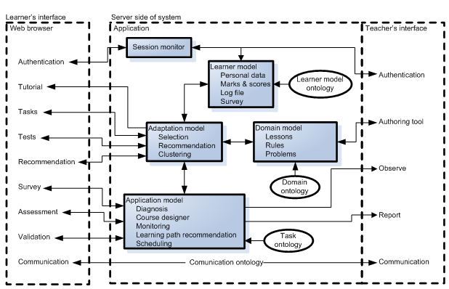
Protus system architecture

Slide 20
Protus Interface
series of web pages that provide two options: taking lessons and testing learner’s knowledge
helps in process of managing data about a learner and course material
Learner’s interface
Teacher’s interface

Slide 21
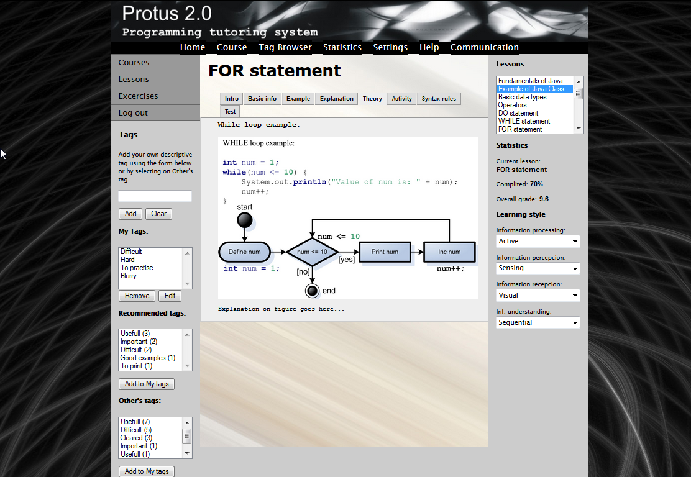

Slide 22
Creating tag in Protus
Click on active learning object in the content and enter arbitrary keywords in the appropriate textfield.
  The system allows participants:
    to enter as many tags as they wish, separated by commas.
    to use spaces in tags, rather than restricting the participant to a single word.
    to use of multi-word tags to eliminate the problem of establishing a convention for word combination.
The functionality available by clicking on an active learning object includes:
  searching and categorization,
  the ability to add tags or notes, and
  to modify/delete selected tags or notes.

Slide 23
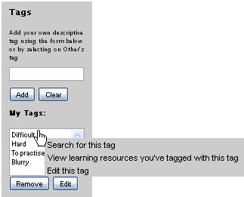
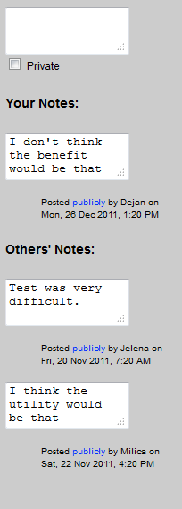
Tagging interface

Slide 24
The recommendation component

Slide 25
The recommendation component
  Learning Style identification - as unique manners in which learners begin to concentrate on, process, absorb, and retain new and difficult information (Dunn et al., 1984) - Index of Learning Styles (ILS) (Felder & Soloman)
    Information Processing: Active and Reflective learners,
    Information Perception: Sensing and Intuitive learners,
    Information Reception: Visual and Verbal learners,
    Information Understanding: Sequential and Global learners.
  Based on results of filled questionnaries - defined clusters
  Recommendation list:
    according to the learners’ and experts’ tags for each generated cluster
    mining the frequent sequences in the server logs by AprioriAll algorithm - Recommendation list (CF) - according to the ratings of these frequent sequences, provided by the Protus system

Slide 26
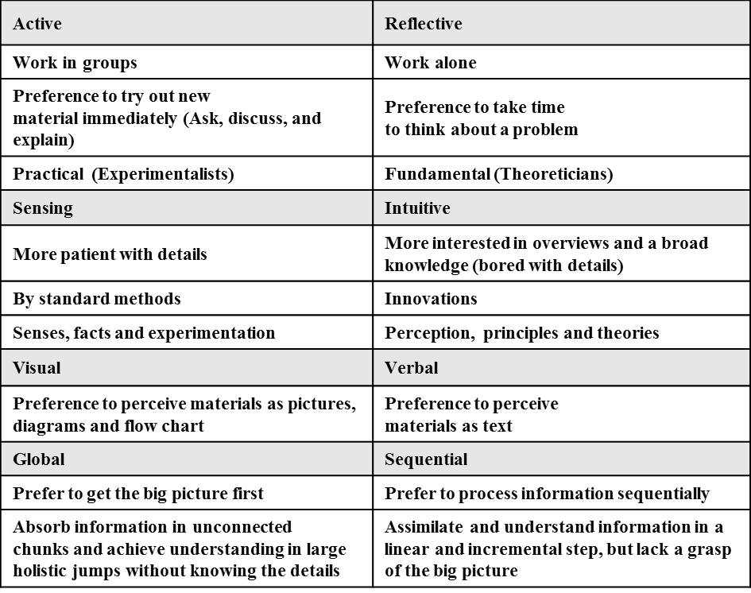
Index of Learning Styles

Slide 27
Outline
✓
1
Aims and Research Objectives of the Dissertation
✓
2
Recommender Systems, Folksonomy and Tag-based Recommender Systems
✓
3
Recommender Systems in E-learning Environments
✓
4
Design, Architecture and Interface of Protus System
5
Evaluation and Discussion
6
Conclusions
Notes:
(Introduction: Motivation and)

Slide 28
Experimental Research
Group of 440 undergraduate students of Higher School of Professional Business Studies at University of Novi Sad
  340 experimental group - were required to use the Protus system.
  100 control group - learned with the previous version of the system and did not receive any recommendation or guidance through the course
Whether the means of two groups are statistically different from each other - the t-test was utilized.
Both groups of learners completed the Norm-referenced test which allows us to compare learners’ intellectual abilities (Glaser, 1963).
Results of this test were combined with grades that learners earned at a basic computer literacy course at the first semester of their studies.

Slide 29
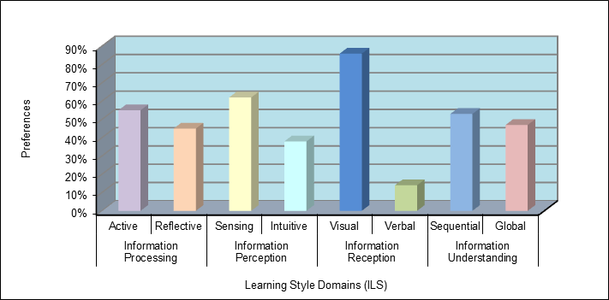
Learning Styles Questionnaire
First step - students fill out the Felder-Solomon “Index of Learning Styles Questionnaire” (ILS).
The aim - cluster learners into a sub-class - learner profiles for 340 learners.

Slide 30
  Statistical Properties of
  Learners’ Tagging History
 | Clust1 | Clust2 | Clust3 | Clust4 | Clust5 | Clust6 | Clust7 | Clust8
Num. of Learners | 44 | 47 | 49 | 48 | 35 | 42 | 39 | 36
Num. of LO | 72 | 72 | 72 | 72 | 72 | 72 | 72 | 72
Num. of Tags | 2402 | 2707 | 3283 | 2380 | 2243 | 2486 | 2289 | 2268
Avg. Num. of Tags per Learners | 54,6 | 57,3 | 67 | 49,6 | 64,1 | 59,2 | 58,7 | 63
Avg. Num. of Tags per LO | 33,4 | 37,6 | 45,6 | 33,6 | 31,6 | 34,5 | 31,8 | 31,5
Learner activities on LOs
Learner activities on tags

Slide 31


Experimental Protocol and Evaluation Metrics
The data set is randomly divided into training set and a test set with sizes 80 and 20 percent of the original set, respectively.
As performance measures for item and tag recommendations, we use the classic metrics of precision and recall which are standard in such scenarios:
  Precision is the ratio of the number of relevant tags in the top-N list (i.e., those in the top-N list that belong in the future set of tags posted by the test user) to N.
  Recall is the ratio of the number of relevant tags in the top-N list to the total number of relevant tags (all tags in the future set posted by the test user).

Slide 32
Comparison of Algorithms

Slide 33
Educational research measures
Whether learners actually do benefit from the usage of the recommender system.
From the educational point of view, learners only benefit from learning technology when it makes learning more
  effective - time that learners needed to reach their learning goal
  efficient - measure of the total amount of completed, visited, or studied lessons during a learning phase
  attractive - satisfaction reflects the individual satisfaction of learners with the given recommendations. Satisfaction is closely related to the motivation of the learner and therefore a rather important measure for learning.

Slide 34
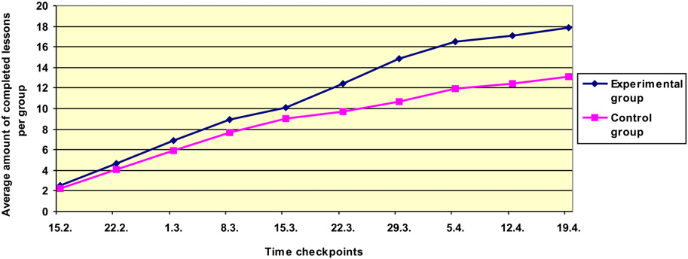
Educational research measures
In our study, we tracked only lessons that are successfully completed, meaning that learners passed the appropriate test at the end of the particular lesson.
We randomly selected a sample of 100 learners from the experimental group and 100 learners from the control group.
Average completion of lessons per group

Slide 35
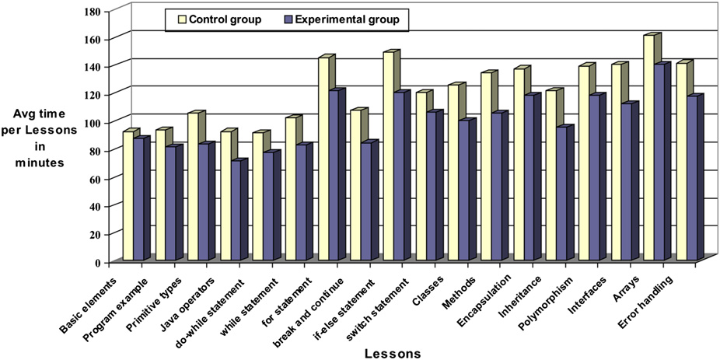
Efficiency comparison

Slide 36
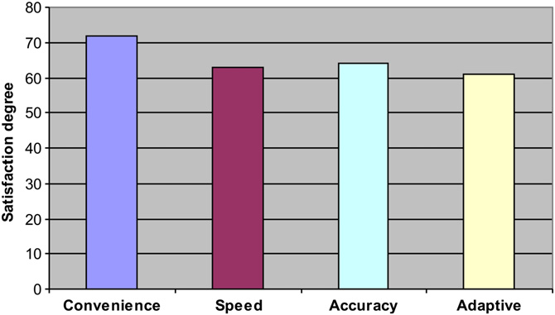
Subjective evaluation
At the end of the course a non-mandatory questionnaire that collected learners’ (from the experimental group) opinions about the main features of the system.
Out of 100 learners, 75 filled in the questionnaire.

Slide 37
Outline
✓
1
Aims and Research Objectives of the Dissertation
✓
2
Recommender Systems, Folksonomy and Tag-based Recommender Systems
✓
3
Recommender Systems in E-learning Environments
✓
4
Design, Architecture and Interface of Protus System
✓
5
Evaluation and Discussion
6
Conclusions
Notes:
(Introduction: Motivation and)

Slide 38
Conclusions
Learners can learn more conveniently than before - system meets their need and interest
Including learner’s learning style - better interpretation of the learner cluster
The best method is RTF (Ranking with Tensor Factorization), followed by FolkRank and HOSVD
The tag collection - identify learner’s interests, judgment, comprehension and knowledge level in different topics
The learners have gained more knowledge in less time
Appropriate selection of collaborative tagging techniques - lead to applying the best results in terms of:
  increasing motivation in learning process and
  understanding of the learning content.

Slide 39
Personalization in e-learning systems
prof. dr Mirjana Ivanović
dr Aleksandra Klašnja-Milićević
Department of Mathematics and Informatics
Faculty of Sciences, Novi Sad
Workshop 2014, Sinaia, Romania

